Slide 1

Metrics – Machine Learning
Diptangshu Banik

Slide 2
Overview
Used to determine the performance of a model.
Classification and Regression has different sets of metrics.
There are no metrics for Clustering as there is no Y label in this type of problems.

Slide 3
Classification metrics are based on how many predictions are correct or incorrect.
Regression metrics are based on how close is the predicted value from the actual value.

Slide 4
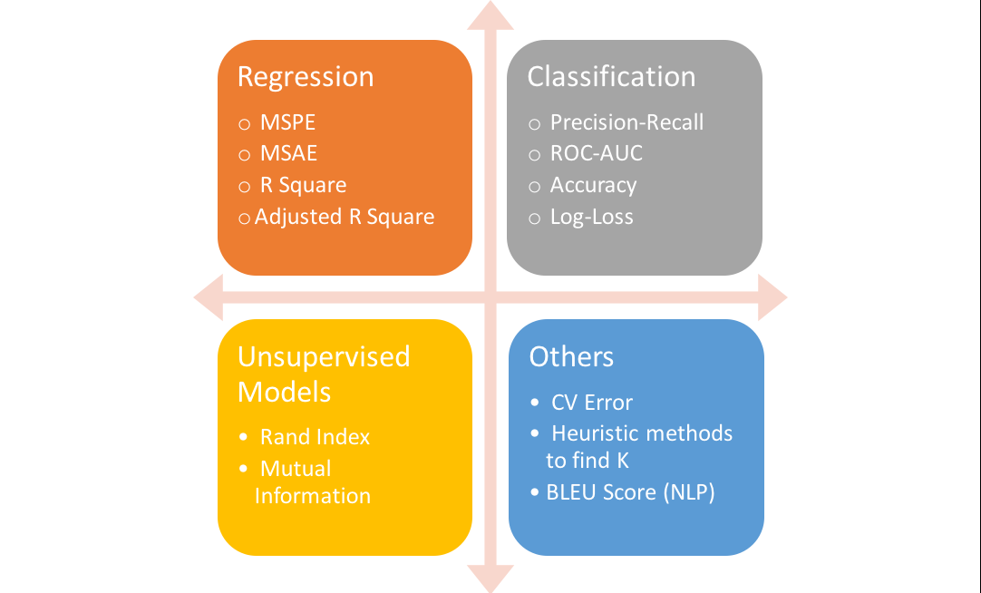

Slide 5
Classification
Classification Accuracy -:
This is when we say accuracy.
Classification Accuracy = No of correct predictions
Total number of predictions made
Works well if there are equal number of samples belonging to each class.
Classification Accuracy is great, but gives us the false sense of achieving high accuracy, when the classes are imbalanced.

Slide 6
Logarithmic loss :
Works well for multi-class classification
When working with Log Loss, the classifier must assign probability to each class for all the samples.
This varies from 0 to infinity [0, ∞)
Log loss nearer to 0 indicates higher accuracy.

Slide 7
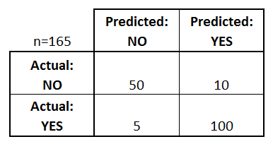
Confusion Matrix :
TN | FP
FN | TP
True negative(TN) Correct prediction | False Positive(FP) Incorrectly predicted as positive.
False Negative(FN) Incorrectly predicted as –ve | True Positive(TP) Correct Prediction

Slide 8
There are 4 important terms :
True Positives : The cases in which we predicted YES and the actual output was also YES.
True Negatives : The cases in which we predicted NO and the actual output was NO.
False Positives : The cases in which we predicted YES and the actual output was NO.
False Negatives : The cases in which we predicted NO and the actual output was YES.

Slide 9
Accuracy = True Positive + True Negative Total number of samples
Precision = TP
(TP+FP)
Precision – Accuracy of positive predictions.

Slide 10
Area Under the Curve (AUC) :
Used for binary classification problem and quality check.
Recall/Sensitivity/True Positive Rate =
True positive
False Negative + True Positive
True Positive Rate is the fraction of relevant instances that have been retrieved over the total amount of relevant instances.

Slide 11
False Positive Rate =
False Positive
False Positive + True Negative
False Positive Rate is the proportion of all Negative data points that are mistakenly predicted as positive, w.r.t. all negative data points.

Slide 12
Area under the Curve (AUC) = Area under the curve of the plot False Positive rates vs True Positive rates at different points [0,1].
The higher the value of our AUC curve, the better the performance of the model.

Slide 13
F1 Score :
It is the harmonic mean between precision and recall.
F1 = 2 * 1
1 1
Precision Recall
Very important measure for classification.

Slide 14
F1 is usually more useful than accuracy, especially if you have an uneven class distribution.
Accuracy works best if false positives and false negatives have similar cost.
If the cost of false positives and false negatives are very different, it’s better to look at both Precision and Recall than the F1 score.

